Slide 1

Minor Project Design and Analysis of Catalytic Converter
Presented by
Aadarsh Kumar, Chekit Sharma, Gulammoin Uddin, Gyandeep Yadav
Supervisor: Mr. Harbhinder Singh(Ass. Professor)

Slide 2
Objectives
To understand the concept of conventional catalytic converter very well and depending on that overcome the various negative aspects.
To design a conventional catalytic converter and improve the performance of conventional catalytic converter by changing its design criteria.
To minimize the backpressure effect on engine by changing and testing the honeycomb structure of catalyst.

Slide 3
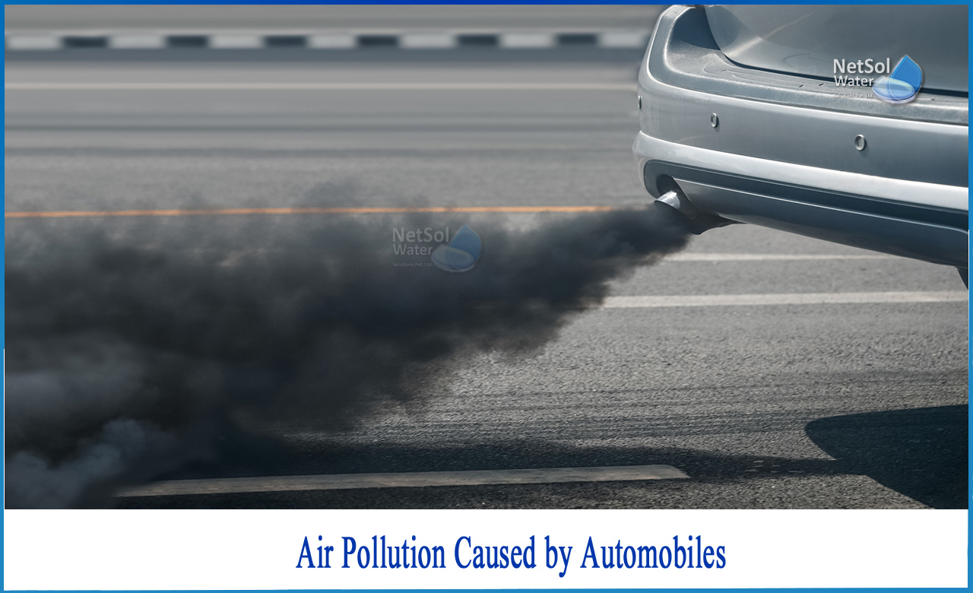
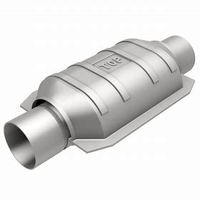
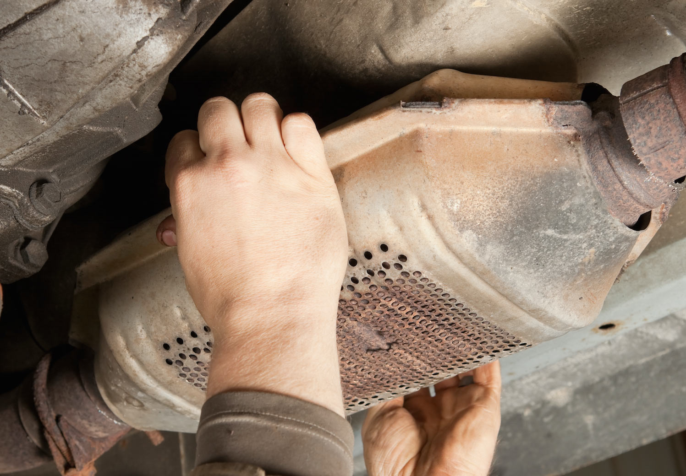
Air Pollution & Role of Catalytic Converter
A major part of the air pollution caused is due to the vehicular emission which is increasing at an alarming rate.
The incomplete combustion of the fuels in the engine paves a way for production of products like CO, hydrocarbons and particulate matters.
Air Pollution caused by vehicle
The most effective after treatment for reducing engine emission is the Catalytic Converter found on most automobiles.
It is a simple device that uses basic redox reaction to reduce the pollutants a car makes.
Catalytic Converter

Slide 4
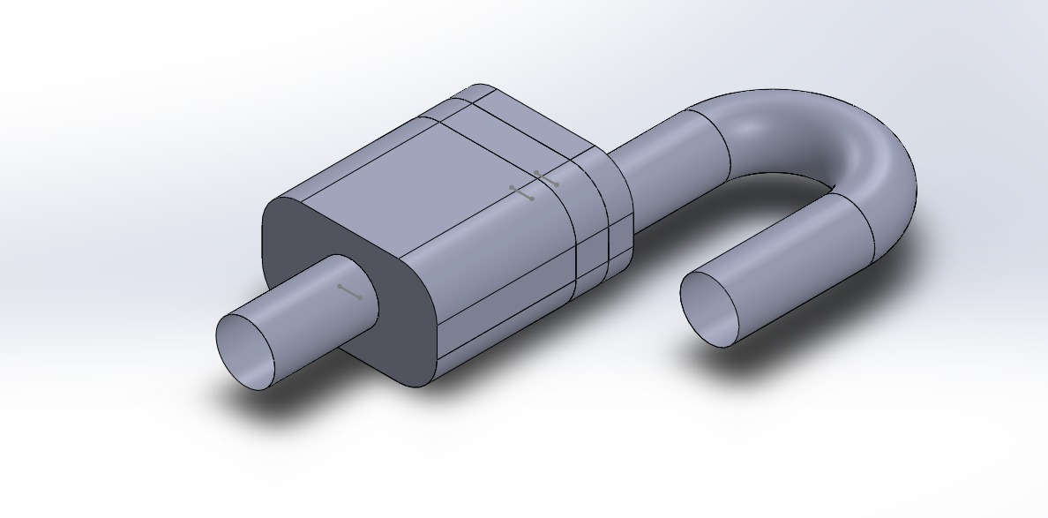
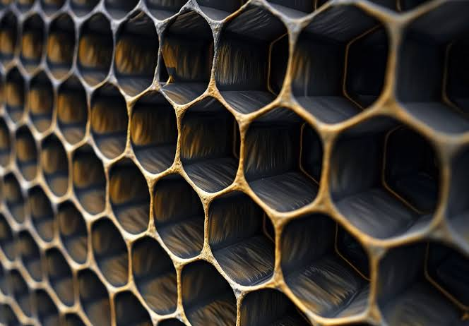
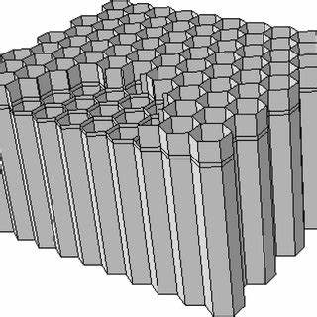
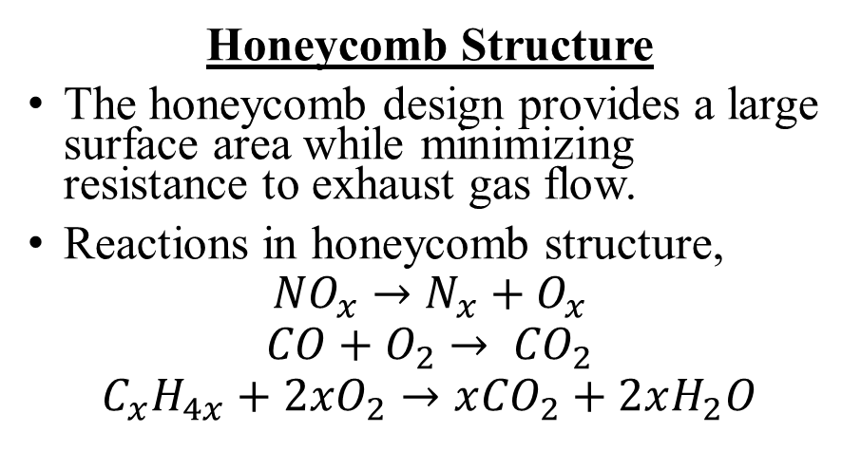
Catalytic Converter
It uses noble metals like platinum and Copper which help in reducing emission by improving combustion efficiency.
It is composed of a metal housing with a ceramic honeycomb-like interior with insulating layers.
Honeycomb Structure
The honeycomb design provides a large surface area while minimizing resistance to exhaust gas flow.
Reactions in honeycomb structure,
$${NO}_{x}→N_{x}+O_{x}$$
$$CO+O_{2}→ {CO}_{2}$$
$$C_{x}H_{4x}+2xO_{2}→x{CO}_{2}+2xH_{2}O$$
Catalytic Converter
Honeycomb Structure

Slide 5
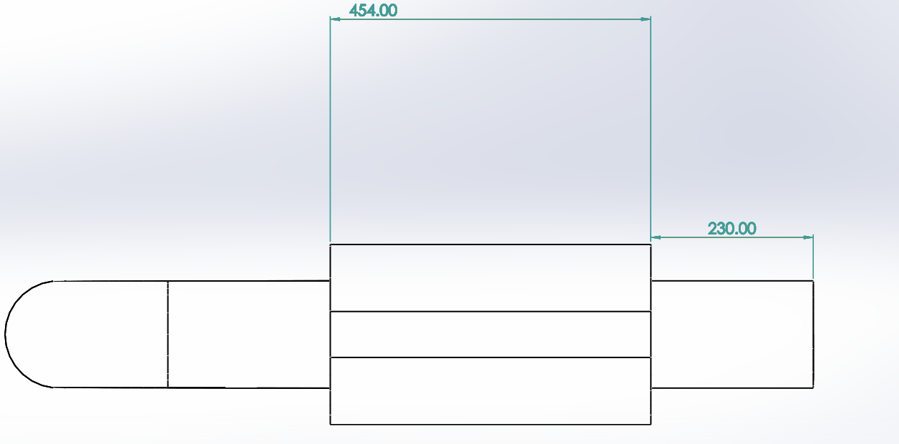
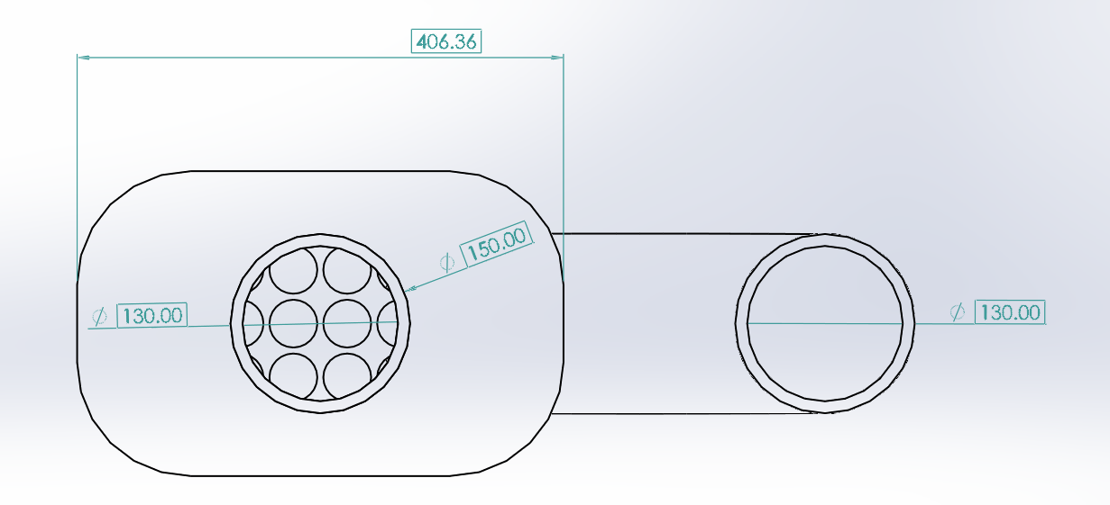
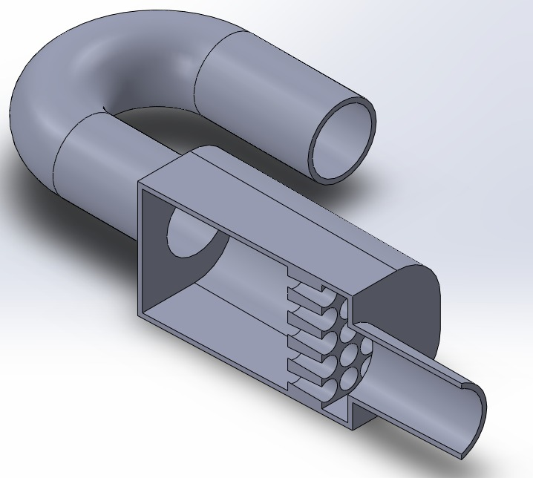
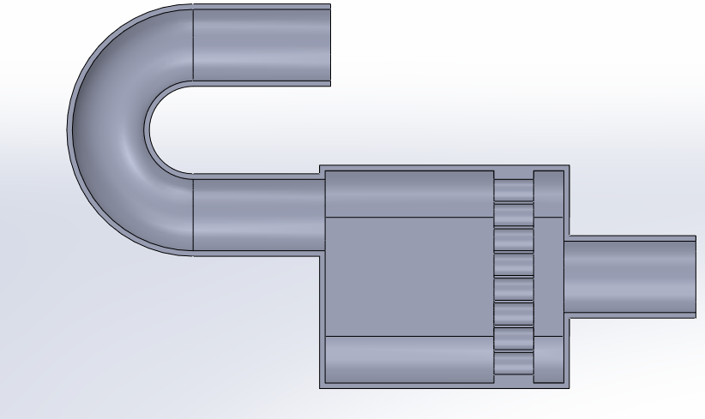
Design of catalytic converter
Software used : SolidWorks
Front View
Side View
3D Model – CATALYTIC CONVERTER
Front Sectional view
Top Sectional View

Slide 6
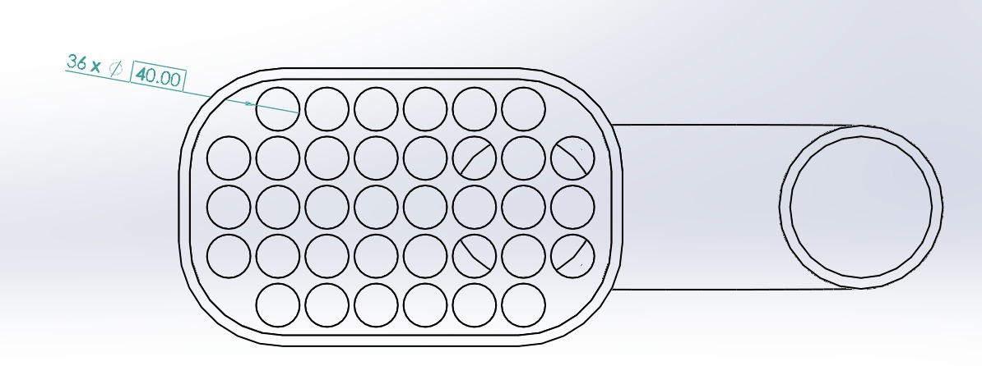
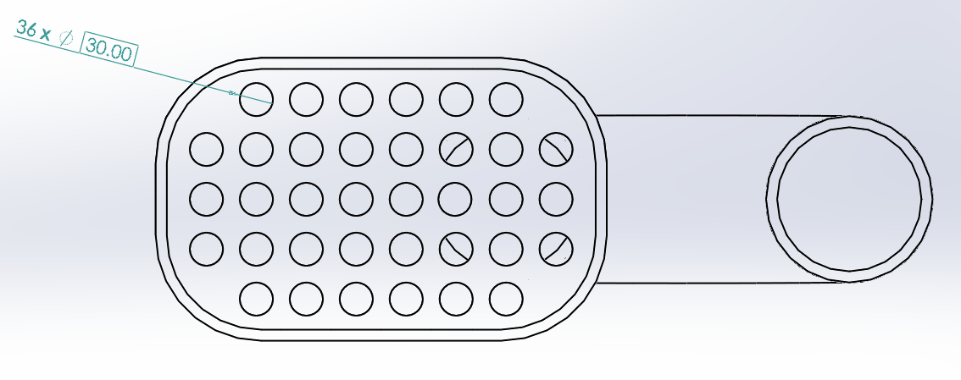
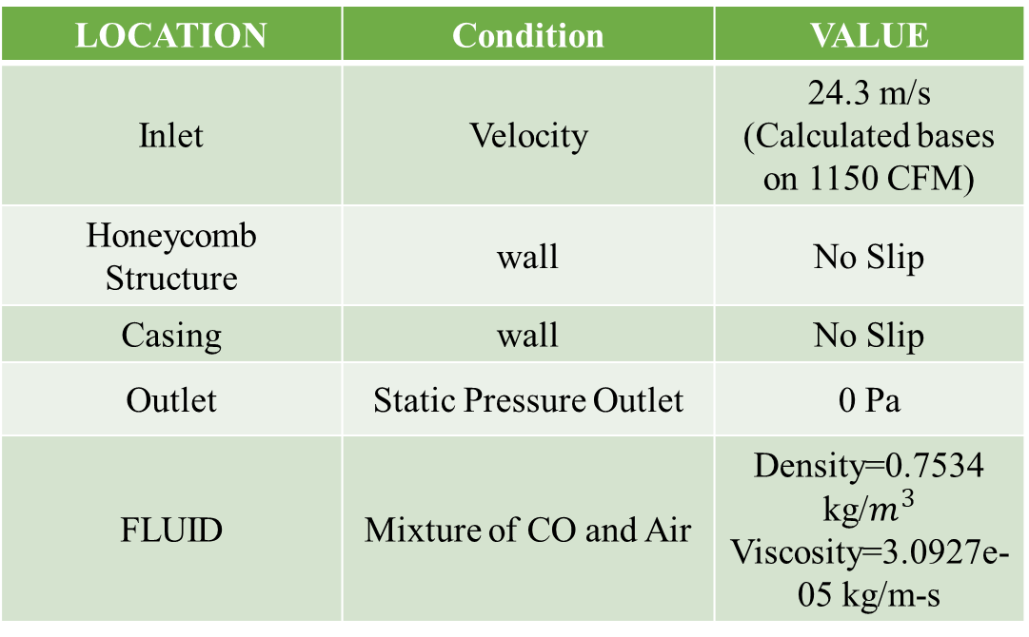
Analysis and Boundary Conditions
Analysis Type - CFD Analysis
Software Used – Ansys Discovery
Cases Considered:
Boundary Conditions
LOCATION | Condition | VALUE
Inlet | Velocity | 24.3 m/s (Calculated bases on 1150 CFM)
Honeycomb Structure | wall | No Slip
Casing | wall | No Slip
Outlet | Static Pressure Outlet | 0 Pa
FLUID | Mixture of CO and Air | Density=0.7534 kg/$m^{3}$ Viscosity=3.0927e-05 kg/m-s
Hole Dia – 40 mm
Hole Dia – 30 mm

Slide 7
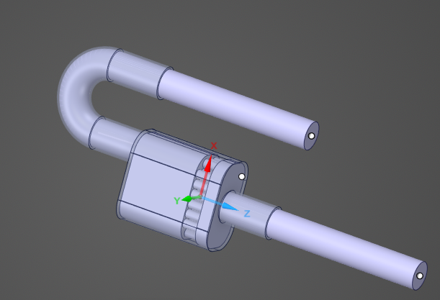
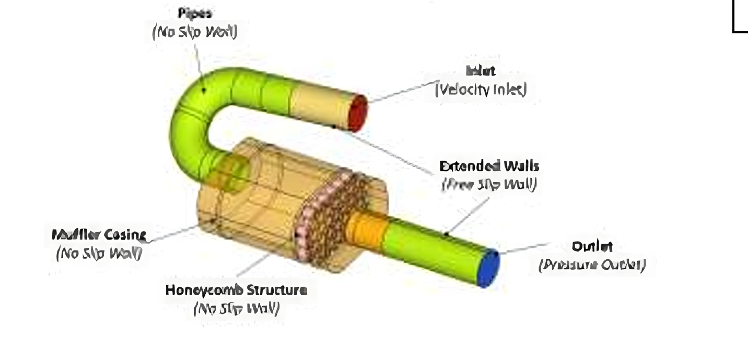
Analysis Setup
Steps Taken for Analysis setup:
CFD domain from Catalytic converter geometry is extracted.
Only wetted surfaces are considered for CFD domain.
Actual Inlet is extended further by 3D (D=Inner diameter of pipe) distance to develop uniform flow profile on actual inlet and actual outlet.
Wetted Surface and Extended inlet and Outlets
Assumptions for simulation:
Flow is assumed steady flow.
The fluid entering inside domain through inlet is considered as uniform.
It is assumed that material property of fluid is isotropic in all regions.

Slide 8
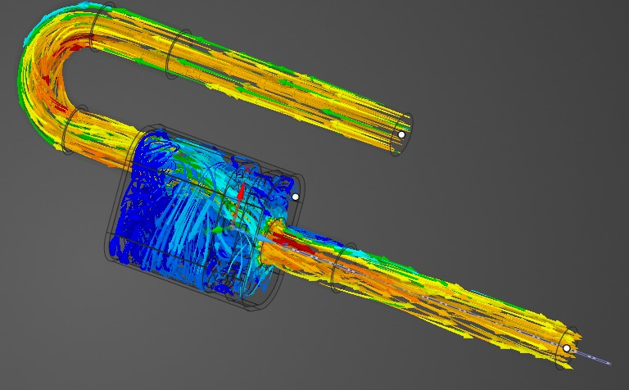
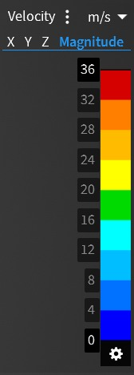
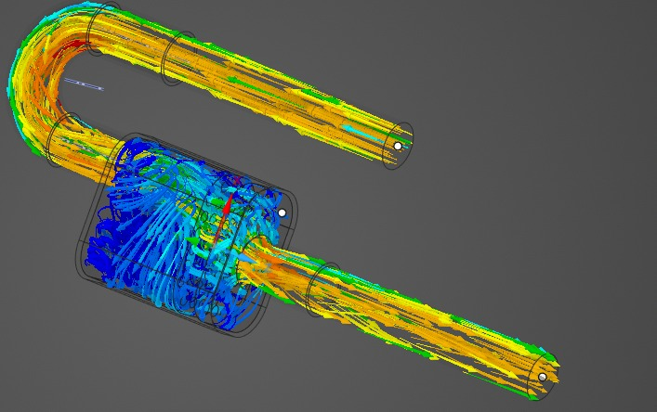
Post Processing and Results
Flow Velocity Observation:
The fig shows the flow of the exhaust gas inside the catalytic converter. As we have considered two honeycomb structure cases:
Base case - 40 mm hole dia.
Modified case – 30 mm hole dia.
Observation:
flow is not uniformly distributed inside casing which is diverted on one side because of inlet pipe center offset.

Slide 9
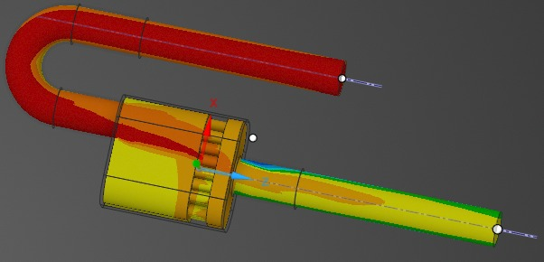
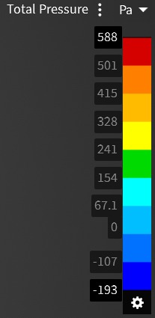
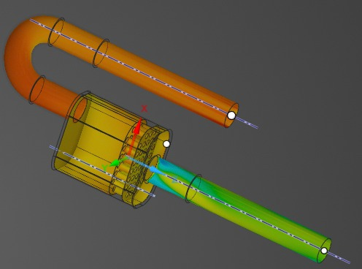
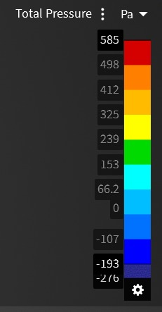
Pressure drop Observation:
(a) 40 mm case pressure drop:
588 Pa to -193 Pa
(b) 30 mm case pressure drop:
585 Pa to -273 Pa
Pressure drop is more in case of 30 mm dia.
This reduced the back pressure effect on the engine thus increasing efficiency of engine.
(a)
(b)

Slide 10
Future Work
Study location wise pressure drop using pressure monitors to study detailed effect of honeycomb hole reduction.
To minimize the backpressure effect on engine by changing and testing the honeycomb structure of catalyst.

Slide 11
THANKYOU

